Slide 1


PY-EXPO
2K24
Team ID: T027
Team Name: BREAKING BAD
Genius innovation leaves behind a legacy...
PYEXPO 2K24

Slide 2
PS Code: PY186
Problem Statement:
AUTOMATED ESSAY GRADING
Automated essay grading utilizes artificial intelligence and natural language processing tAutomated essay grading utilizes artificial intelligence and natural language processing to assess essays quickly and efficiently. By analyzing linguistic features, content relevance, and structure, it provides objective feedback and scores, aligning with established grading criteria. Calibration techniques ensure accuracy and consistency, enhancing the reliability of the grading process.o assess essays quickly and efficiently. By analyzing linguistic features, content relevance, and structure, it provides objective feedback and scores, aligning with established grading criteria. Calibration techniques ensure accuracy and consistency, enhancing the reliability of the grading process.
PYEXPO 2K24

Slide 3
Solution
*It is more accurate
*It will drastically reduces the time
*user friendly
*it replace the human grader
*grading manually allows for content,style
\
Technology Stack
Python
Html
Css
PYEXPO 2K24

Slide 4
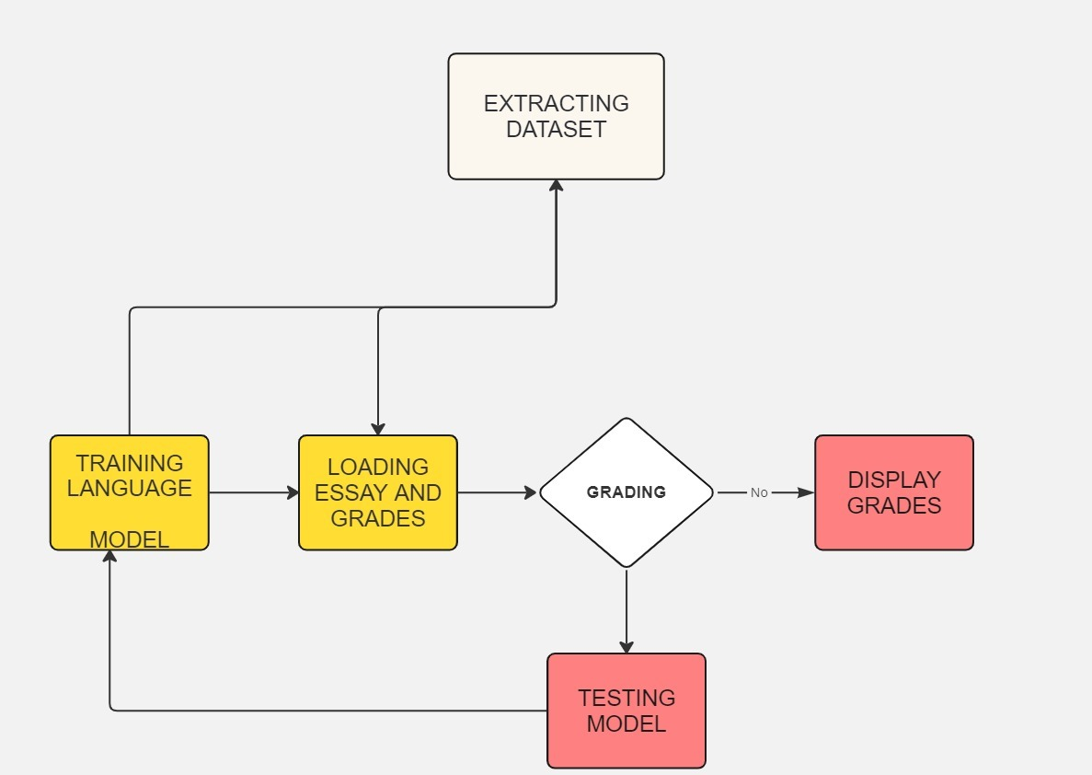
PYEXPO 2K24

Slide 5
Team Member Details:
M.S.SUJITH
PRADEEP.S
SANJAYKUMAR.G
VISWAJITH.P.M
PYEXPO 2K24

Slide 6

Thank You
Any Queries?
PYEXPO 2K24

